Slide 1

Embedded System Architecture
by Rimantas Januškevičius

Slide 2
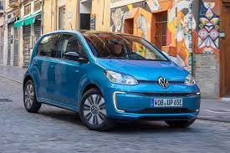
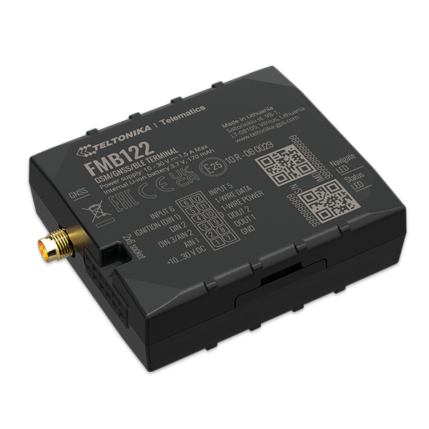
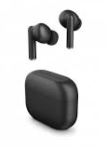
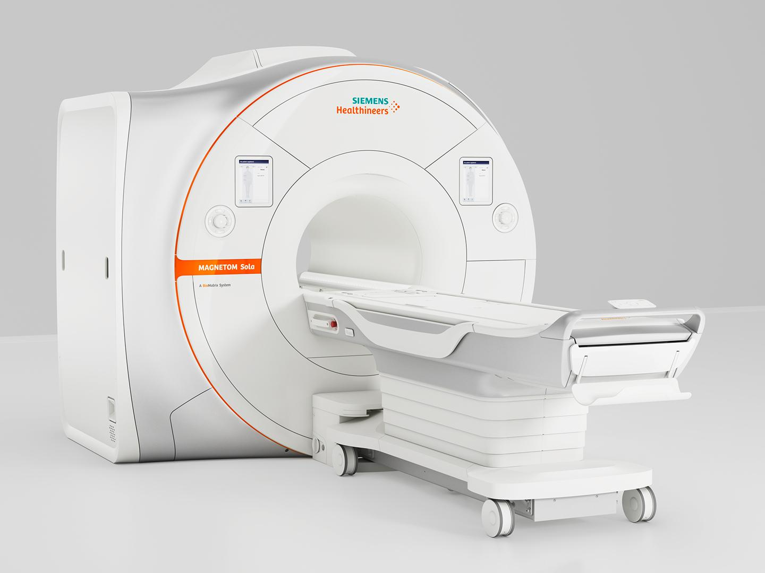
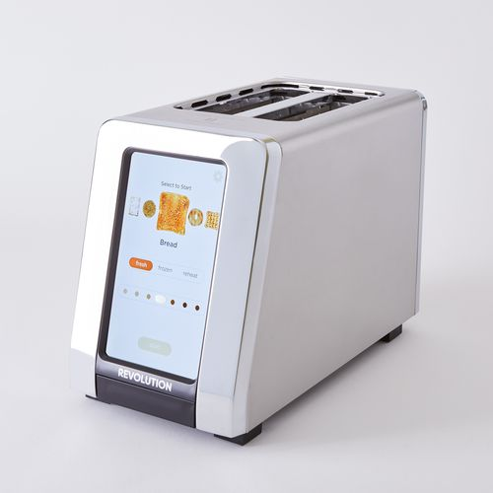
Embedded devices
Vehicle computers
Medical equipment
Electronic gadgets
Smart home devices
GPS trackers
Many more

Slide 3
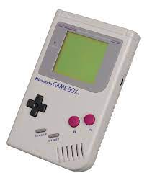
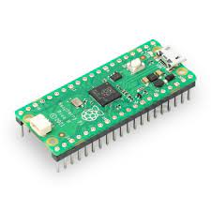
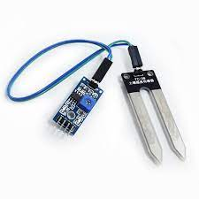
What makes a device embedded
Narrow specialization
Lacking general-purpose user interfaces
Limited resources
Many varying peripherals
Runs without OS or with a specialized one

Slide 4
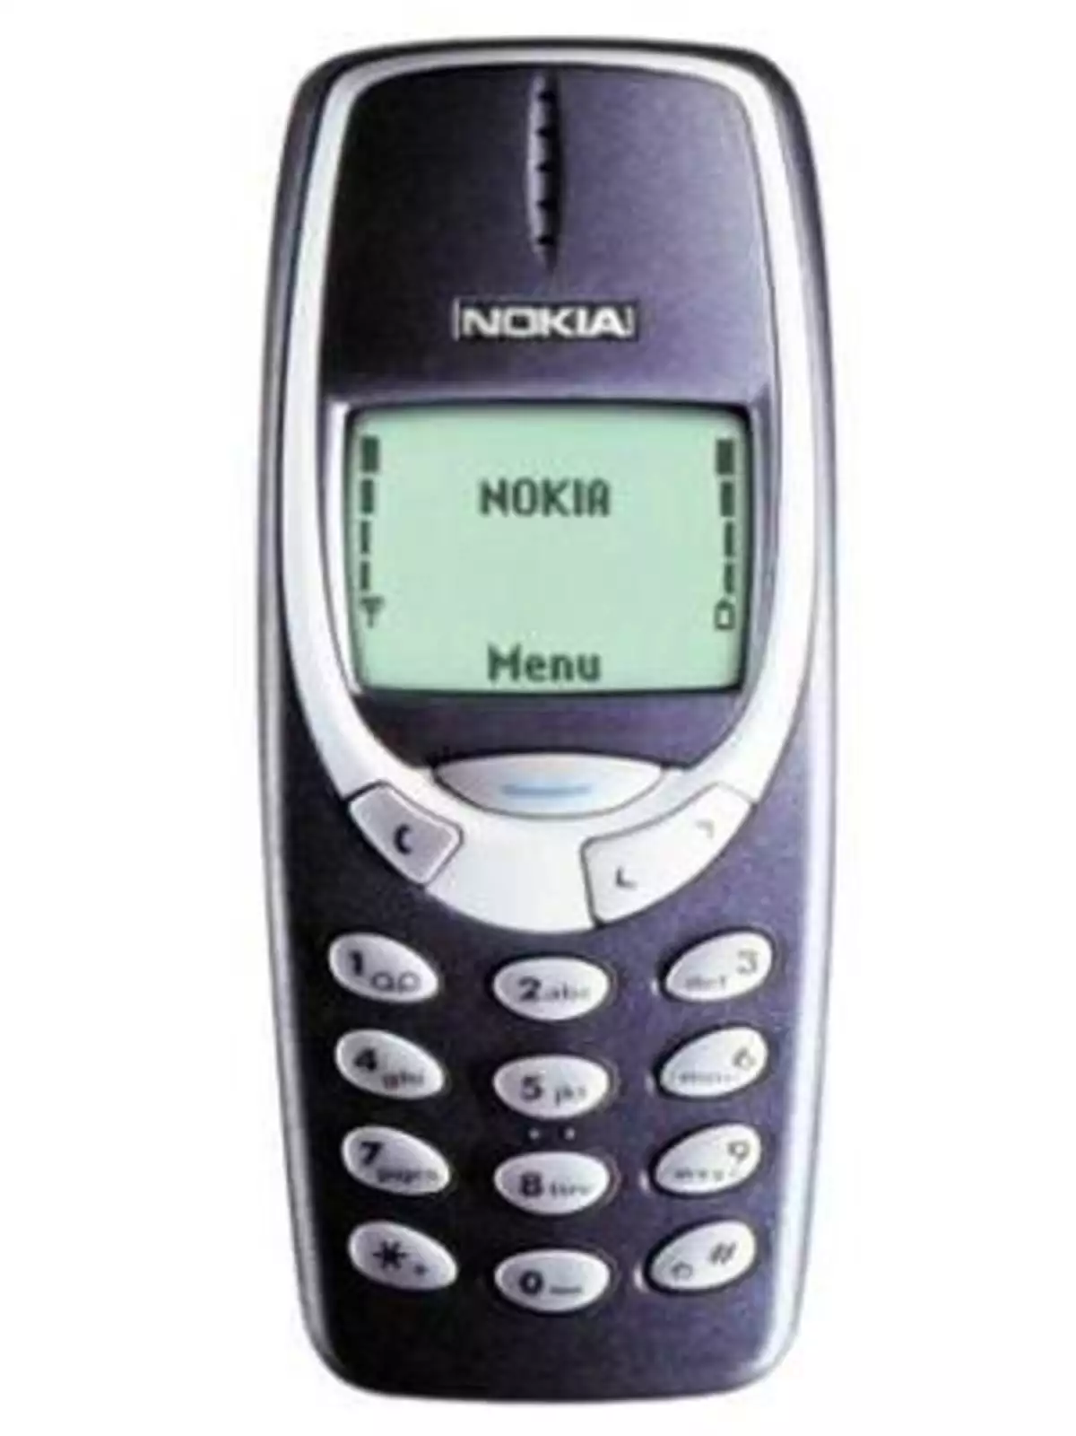
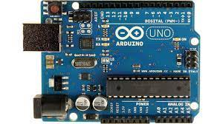
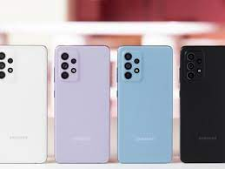
Arguably Embedded
Phones
Old phones - certainly
Smartphones - arguably
Raspberry Pi microcomputers
Arduino microcomputers

Slide 5

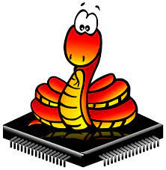

Commonly used languages

Slide 6

Design Questions
How to run the program?
Single-thread or multi-thread?
How will processor time be distributed?
How to handle exceptions?
Will an OS be used?
How will the memory be managed
There can be many different
What if peripherals change
Will we update software in our devices?

Slide 7
Principles
Modularity
Separation of concerns
Single responsibility
Cohesion
Encapsulation
DRY

Slide 8
Design patterns
Round Robin
Function Queue
RTOS

Slide 9
Round Robin
Runs in a loop
Polls peripherals
Very simple
Execution time is not guaranteed
Variation: adding interrupts

Slide 10
Function Queue
Runs in a loop
Has interrupts
Has follow-up handlers
Handles go to queue by priority
Low-priority tasks may not be executed

Slide 11
RTOS
Real-time operating system
Not necessary
Can make a large program easier to manage
Main purpose – multi-tasking
Scheduler
Software timers
Often frowned upon
Thread communication

Slide 12
Architectures
Layered
Hexagonal

Slide 13
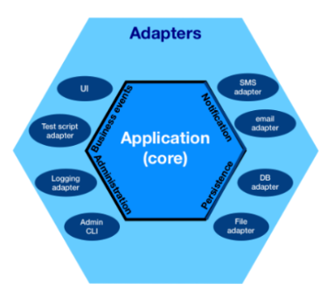
Hexagonal
Ports and adapters
Is divided in ports
Each port is a functioning module
Ports communicate via adapters
Like interfaces
Notes:
application core, the database, the user interface, test scripts and interfaces with other systems

Slide 14
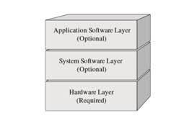
Layered
The deepest layer for the drivers
GPIO
Communication connections
A layer to abstract the drivers - API
Functions to use GPIO to switch LEDs
Functions to read / write via communication channels
One more for implementing use cases
Making the LEDs blink in a pattern on command sent via the channels

Slide 15
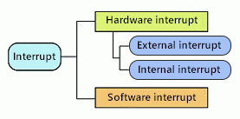
Interrupts
Can come from the processor
Additional can be created by the RTOS
Benefits from having priorities

Slide 16
Scheduling
Deciding how do distribute time:
First come – first served
Not fit for long-running tasks
No priorities
Round robin
Each task gets a slice
And goes back to queue
Variation uses priorities
Cooperative
Task runs until it finishes or blocks voluntarily
Preemptive
Highest priority task is run

Slide 17
Updating the devices
In person
Connecting physically
Flashing software
Often not feasable
Remotely
Using a Flasher that the client connects his devices to for updating
Outfitting the device with updateware
Extra code overhead
More overhead for backup
Suggest the client buys new device :)
Notes:
Tai aktualu tiek sektorizacijai, tiek konfigūracijai. Nes pagal apkrovą vertinama kuriuos sektorius mažinti, didinti, padalinti ar sujungti. Apkrova dažnai buvo dalinama į tris kategorijas: stebėjimo, koordinacijos ir konfliktų sprendimo
Apkrova literatūroje vertinta įvairiai:
Tiesiog emamos gryns metrikos - lėktuvų koordinatės, greitis ir kitos
Kitas apibūdintas metodas - vertinti krūvį pagal realiai atliekamas užduotis

Slide 18
Watchdogs
Hardware
A Hardware timer
Needs regular resetting
Can do a hard reset
Software
Runs on sheduler’s given time
Monitors responsiveness or other parts of the program usually tasks
Can reset parts of the program or perform a soft reset

Slide 19
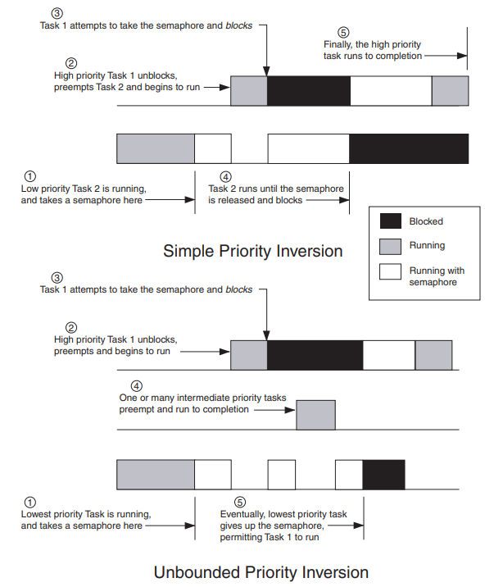
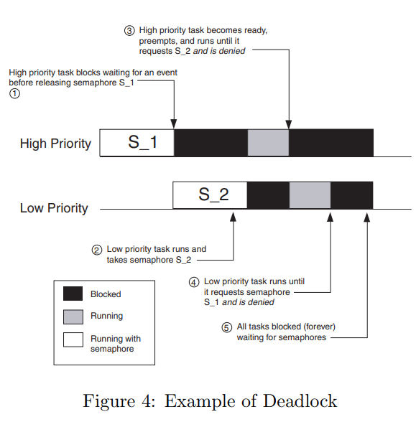
Problems
Critical section
Deadlock
Other time-related problems
Inversion of priority
Notes:
Critical section:
Atomic operations
Disabling interrupts
Deadlock
Watchdog
Inversion of priority
Priority innheritance

Slide 20
[Spotlight to the audience]
Your chance to ask

